Slide 1

Ideation in AI Projects
Master 1 SDIA
Prof. Layeb A.

Slide 2

Ideation: Definition
Ideation is the creative process of generating, developing, and communicating new ideas. It's a crucial stage in various endeavors, including:
Product development
Problem-solving
Business strategy
Design thinking
AI project development

Slide 3
The Aims of Ideation
Guiding Project Direction:
Ideation helps in generating creative and diverse ideas to address challenges or leverage opportunities.
Enhancing Solution Relevance:
Well-defined ideation ensures that AI solutions align with the actual needs and objectives of stakeholders.
Encouraging Innovation:
Ideation fosters a culture of innovation, encouraging teams to think outside the box and explore unconventional approaches.
Optimizing Resource Utilization:
Ideation ensures that resource investments are directed towards solutions that have the most significant impact.

Slide 4
The Aims of Ideation
Facilitating Stakeholder Engagement:
Stakeholders are more likely to engage and support a project with a well-framed problem and a compelling ideation.
Clear communication of project goals and benefits enhances collaboration and stakeholder buy-in.
Mitigating Risks:
Ideation provides opportunities to anticipate challenges and develop strategies for overcoming obstacles.
Improving Decision-Making:
Ideation and problem framing contribute to informed decision-making by providing a structured approach to understanding the problem landscape.
Iterative Development and Adaptability:
Well-framed problems and creative ideation enable an iterative development approach.
Teams can adapt to evolving project requirements, ensuring the AI solution remains relevant and effective over time.
Elevating User Experience:
Ideation allows for the development of features that enhance user experience and satisfaction.

Slide 5
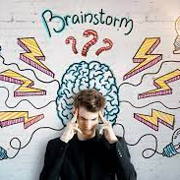
Ideation Techniques: Brainstorming
Description: A group creativity technique where participants generate a large number of ideas in a short amount of time.
Process:
Define the Problem: Clearly articulate the problem or challenge.
Generate Ideas: Encourage participants to freely express their ideas without judgment.
Divergence: Collect a variety of ideas.
Convergence: Discuss and refine the most promising ideas.

Slide 6

Ideation Techniques: Brainstorming
Quantity over quality:
Defer judgment: Avoid critiquing or evaluating ideas during the brainstorming session.
Build on others' ideas: Encourage participants to piggyback on and elaborate on each other's ideas, fostering collaboration and generating new possibilities.
Encourage wild ideas: Don't censor unconventional or seemingly impractical suggestions.

Slide 7
Ideation Techniques: Brainstorming techniques
Individual brainstorming: Individuals silently generate ideas on their own before sharing them with the group.
Group brainstorming: Participants share ideas verbally, building upon and expanding on each other's suggestions.
Brainwriting: Participants write down their ideas individually and pass the paper to the person next to them who adds their own idea and so on, ensuring everyone contributes to each idea.
Brain-mapping: Participants create a visual diagram with the central problem at the center and branches representing connected ideas.

Slide 8
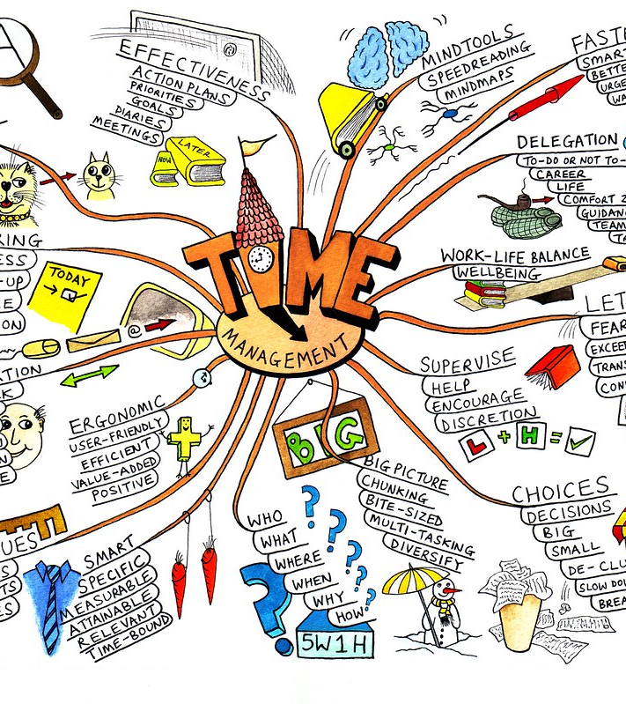
Ideation Techniques: Mind Mapping
Description: A visual representation technique where ideas are organized around a central concept.
Process:
Start with a Central Idea: Write the problem statement or main theme in the center.
Branch Out: Create branches for related sub-themes or potential solutions.
Expand Further: Add details, connections, and additional ideas to each branch.
Analyze and Prioritize: Review the mind map to identify key ideas and relationships.

Slide 9

Ideation Techniques: SCAMPER
Description: An acronym representing different creative thinking prompts (Substitute, Combine, Adapt, Modify, Put to another use, Eliminate, Reverse).
Process:
Substitute: Consider alternatives for components or processes.
Combine: Merge different elements or features.
Adapt: Modify existing elements to suit the problem.
Modify: Change specific aspects or characteristics.
Put to another use: Explore alternative applications.
Eliminate: Remove unnecessary elements.
Reverse: Flip the problem or solution perspective.

Slide 10
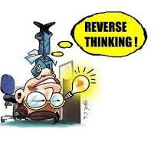
Ideation Techniques: Reverse Thinking
Description: Approaching the problem by considering the opposite or reverse of conventional solutions.
Process:
Identify the Conventional Solution: Understand the typical approach.
Reverse It: Consider the opposite or reverse of each element.
Generate Ideas: Develop solutions based on the reversed perspective.
Evaluate: Assess the viability of the reversed ideas.

Slide 11
Ideation Techniques: Reverse Thinking
Examples of Reverse Thinking:
Business: Instead of asking "how can we increase customer satisfaction?", you might ask "what would make customers **unhappy **with our product/service?"
Design: Instead of asking "how can we make this product more user-friendly?", you might ask "how can we make this product deliberately difficult to use?" (to identify potential usability flaws)
Marketing: Instead of asking "how can we promote this product to a wider audience?", you might ask "how can we deliberately limit the appeal of this product to a specific target audience?"

Slide 12
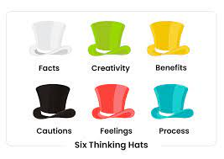
Ideation Techniques: Six Thinking Hats
The Six Thinking Hats is a powerful tool created by Dr. Edward de Bono, designed to improve individual and group thinking
promoting parallel thinking and structured communication.
It provides a framework for approaching a situation from six different perspectives:
1. White Hat: The "Information" Hat *
Focus: Gathering and analyzing information objectively.
Purpose: To seek and present facts, data, and evidence related to the situation without judgment or interpretation.
Example questions: "What information do we have?" "What data is relevant?" "What are the facts of the situation?"

Slide 13
Ideation Techniques Six Thinking Hats
2. Red Hat: The "Emotional" Hat
Focus: Expressing emotions and intuition freely.
Purpose: To acknowledge and express feelings
Example statements: "I feel worried about..." "This idea makes me excited because..." "I have a bad feeling about this."
3. Black Hat: The "Critical" Hat
Focus: Identifying potential problems, risks, and weaknesses.
Purpose: To analyze and identify potential flaws, limitations, and negative consequences of ideas or proposals.
Example questions: "What are the potential downsides of this approach?" "What could go wrong?" "What are the limitations of this solution?"

Slide 14
Ideation Techniques: Six Thinking Hats
4. Yellow Hat: The "Positive" Hat
Focus: Identifying potential benefits, opportunities, and value.
Purpose: To explore the positive aspects, potential value, and optimistic outlook.
Example questions: "What are the potential benefits of this solution?" "What opportunities does this create?" "What is the best-case scenario?"
5. Green Hat: The "Creative" Hat
Focus: Generating new ideas and possibilities. *
Purpose: To encourage creative thinking, exploration of alternatives, and proposing new solutions and approaches.
Example prompts: "What are some unconventional solutions?" "What innovative ideas can we make?"
6. Blue Hat: The "Process" Hat
Focus: Managing the thinking process and ensuring everyone participates.
Purpose: To guide the discussion, suggest which hat to wear, summarize key points, and ensure fair and balanced thinking.
Example statements: "Let's put on our Black Hats and consider the challenges." "Perhaps we should wear our Yellow Hats now and explore the positive aspects." "What have we learned so far?"

Slide 15
Ideation Techniques: Six Thinking Hats
Using the Six Thinking Hats:
Define the topic or problem at hand.
Choose a hat to wear and discuss the situation from that perspective.
Switch hats periodically to ensure all perspectives are considered.
The Blue Hat can be used throughout the process to manage the discussion and ensure fair participation.
Benefits of the Six Thinking Hats:
Promotes diverse thinking: Encourages participants to consider different perspectives and avoid groupthink.
Improves communication: Provides a structured framework for expressing and understanding different viewpoints.
Sparks creativity: Encourages exploration of new ideas and innovative solutions.
Enhances decision-making: Provides a comprehensive understanding of the situation before making choices.

Slide 16
Tips for Effective Ideation:
Diversity of Participants: Include individuals with varied backgrounds and expertise for a broad range of perspectives.
Time Constraints: Set time limits for ideation sessions to foster quick thinking and prevent overthinking.
Combine Techniques: Mix and match ideation techniques for a more comprehensive exploration of ideas.
Encourage Wild Ideas: Foster an environment where unconventional and bold ideas are welcome without judgment.

Slide 17
Applying SCAMPER to an AI Project: Improving Healthcare Diagnosis Accuracy
Problem: Medical misdiagnosis can have severe consequences, highlighting the need for improved diagnostic accuracy.
Applying SCAMPER:
Substitute:
Can we substitute traditional diagnostic methods (e.g., x-rays) with AI-powered analysis of medical images like CT scans or MRIs for improved accuracy?
Can we substitute the need for extensive medical training by developing AI-powered tools that assist doctors to identify potential diagnoses?
Combine:
Can we combine AI analysis with expert medical knowledge to create a hybrid system that leverages the strengths of both?
Can we combine AI algorithms trained on diverse medical datasets to increase the generalizability and accuracy of diagnoses?
Adapt:
Can we adapt existing AI techniques used in other fields, like image recognition, and adapt them to the specific needs of medical diagnosis?

Slide 18
Applying SCAMPER to an AI Project: Improving Healthcare Diagnosis Accuracy
Modify (Magnify & Minify):
Magnify: Can we increase the amount and diversity of medical data used to train AI algorithms to improve their accuracy and generalizability?
Minify: Can we simplify the user interface of AI-powered diagnostic tools to make them easily accessible and understandable to medical professionals with varying levels of technical expertise?
Put to other uses:
Can we use AI-powered diagnosis tools not only for initial diagnosis but also for monitoring patient health and predicting potential health risks?
Eliminate:
Can we eliminate the need for repetitive and time-consuming tasks currently performed by medical professionals by automating them with AI, allowing them to focus on patient interaction and complex cases?
Reverse:
Instead of focusing solely on diagnosing individual patients, could we use AI to analyze larger healthcare trends and identify areas where preventative measures could be implemented to improve overall population health?

